Slide 1
Inner Peace: This is so true
If you can start the day without caffeine,
If you can always be cheerful, ignoring aches and pains,
If you can resist complaining and boring people with your troubles,
If you can eat the same food every day and be grateful for it,
If you can understand when your loved ones are too busy to give you any time
If you can take criticism and blame without resentment,
If you can conquer tension without medical help,
If you can relax without alcohol,
If you can sleep without the aid of drugs,

Slide 2
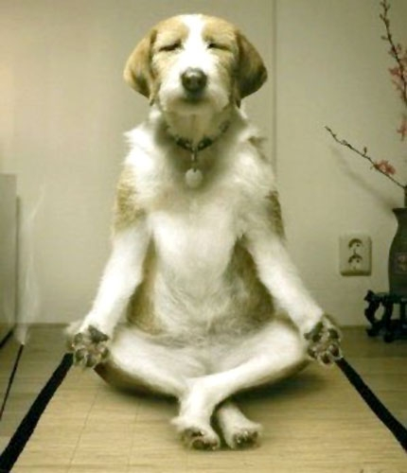
Then You Are Probably The Family Dog!
And you thought I was going to get all spiritual

